Slide 1
Tikhonov regularization
Minjun Kim

Slide 2

Normal equation
$Ax=b →A^{T}Ax=A^{T}b →x={\left(A^{T}A\right)}^{−1}A^{T}b$
$X^{∗}=\min_{x∈ℝ^{m}}{‖Ax−b‖}$ iff $A^{T}Ax^{∗}=A^{T}b$

Slide 3

Pseudo inverse
$Ax=b$
$x=A^{−1}b or x=VΣ^{−1}U^{T}b$

Slide 4
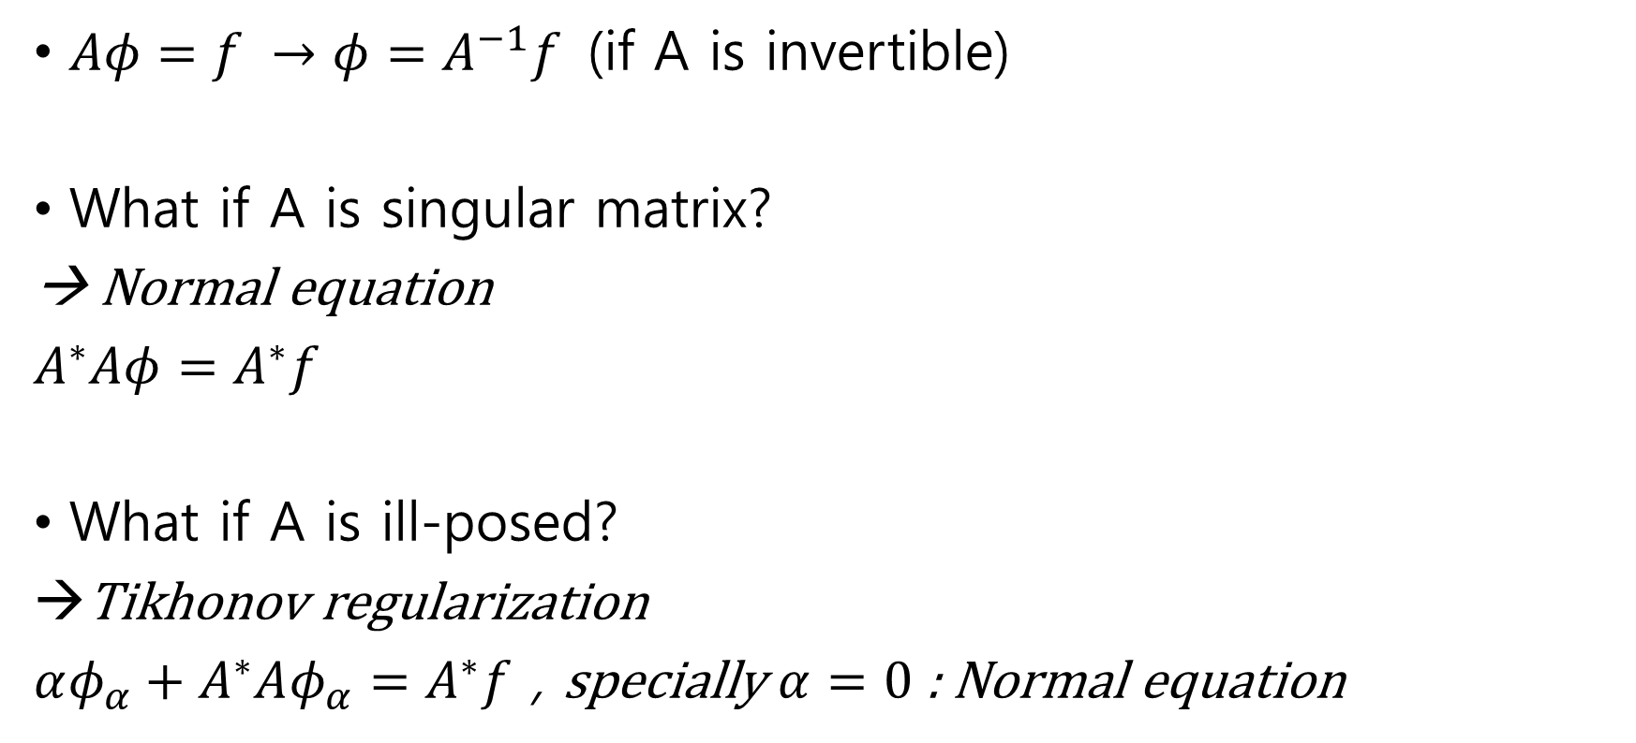
Tikhonov regularization
$Aφ=f →φ=A^{−1}f$(if A is invertible)
What if A is singular matrix?
→ Normal equation
$A^{∗}Aφ=A^{∗}f$
What if A is ill-posed?
Tikhonov regularization
$αφ_{α}+A^{∗}Aφ_{α}=A^{∗}f$ , specially $α=0$ : Normal equation

Slide 5

Tikhonov regularization
$αφ_{α}+A^{∗}Aφ_{α}=A^{∗}f$
$(αI+A^{∗}A)φ_{α}=A^{∗}f$
$φ_{α}={\left(αI+A^{∗}A\right)}^{−1}A^{∗}f$ → ${\left(αI+A^{∗}A\right)}^{−1}A^{∗}=R_{α}$

